Slide 1
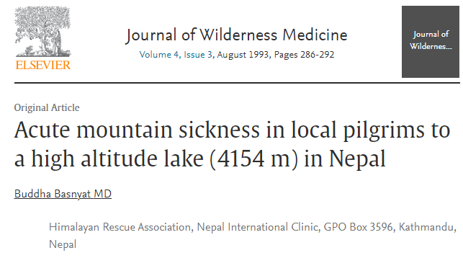
Prepared by Pashupati Pokharel

Slide 2
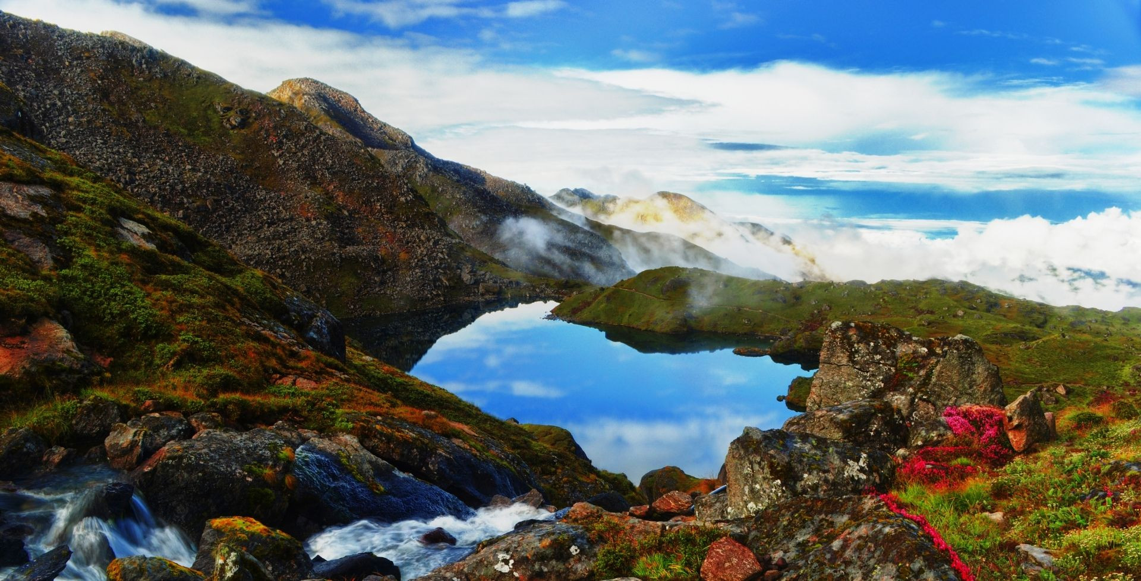
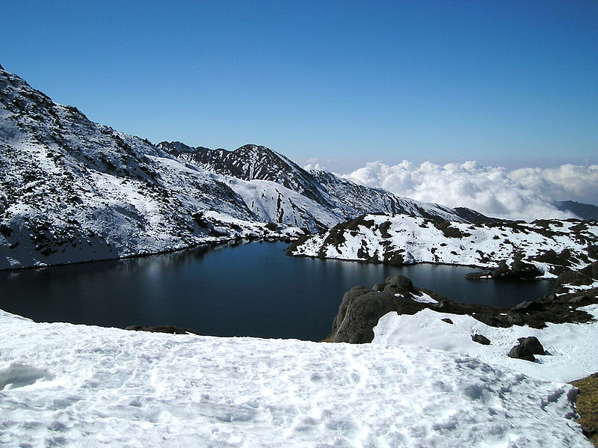
Gosaikunda
Location: Rasuwa district, Lamtang National Park
Altitude: 4380m (4154m in this paper)
People visit the lake during Janai Purnima to worship Lord Shiva.

Slide 3
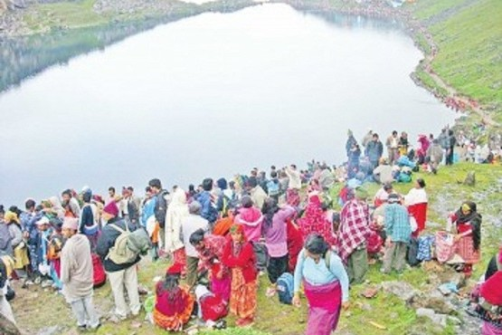
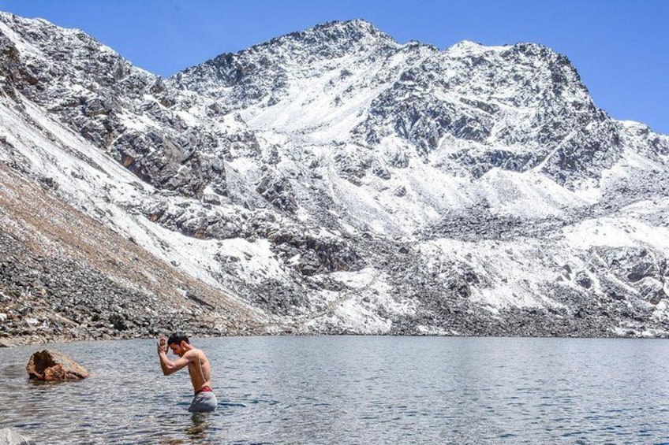
During Janai Purnima

Slide 4
Introduction of the Paper
Back in the early 90s, paucity of evidences on acute mountain sickness (AMS) among Nepali population.
During Janai Purnima, thousands of Nepali pilgrimages travel to Gosaikunda.
Himalayan Rescue Association sets a temporary health camp every year targeting pilgrims.
In the year 1991, eight medical students from Tribhuvan University, Institute of Medicine, and two doctors went as a part of temporary aid camp.
This provided excellent opportunity to Dr. Buddha sir to bridge the research gap on AMS.

Slide 5
Methodology

Slide 6
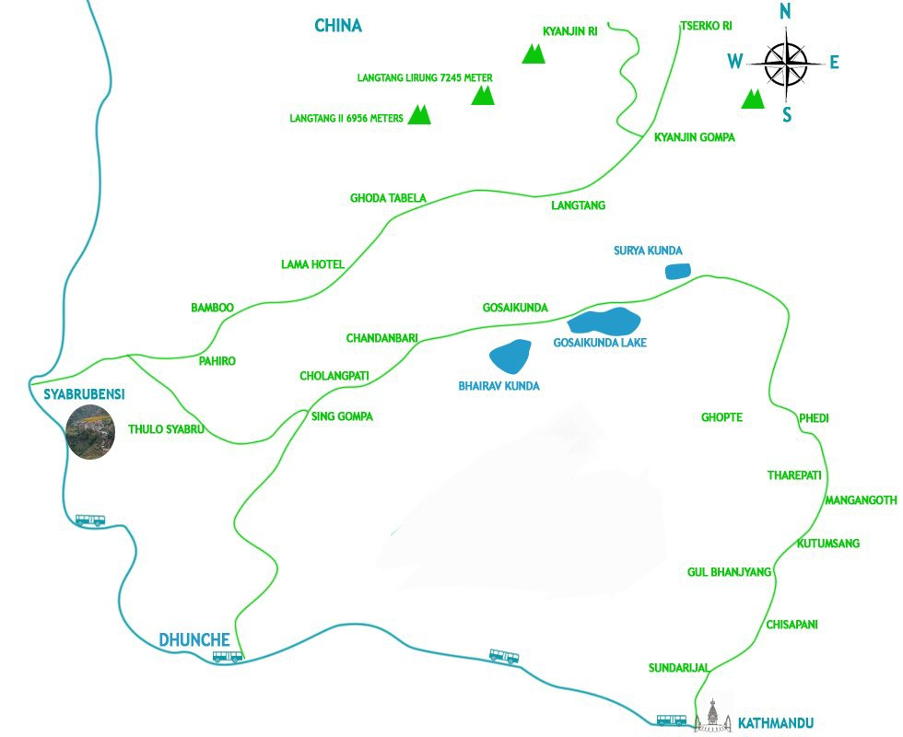
Source: pathway to gosaikunda - Google Search
4154m
3168m
1187m
1914m

Slide 7
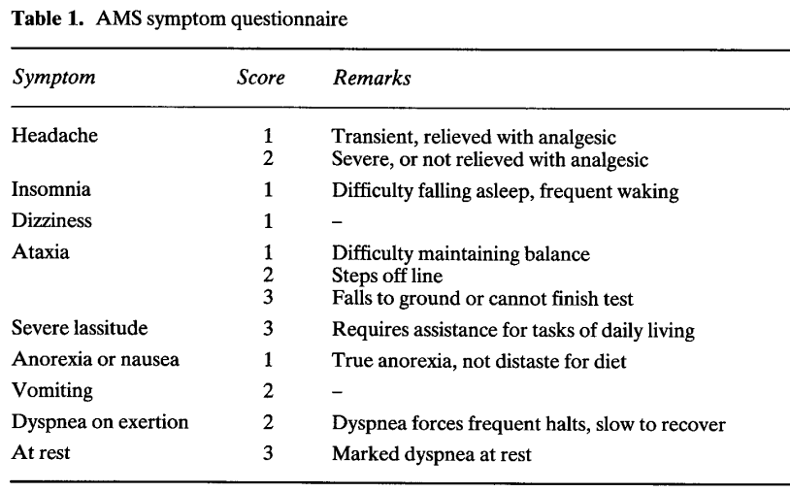
Score
Mild AMS: 2-4
Moderate AMS: 5-11
Severe AMS: 12-18

Slide 8
Results
Total number of pilgrims: 5163
4343 (84%) came from Dunche side; 820 (16%) came from Sundarijal side.
Age: 14-78 years (mean= 44)
Patient developing AMS: 229 (4.4%)

Slide 9
Results Continued….
99.6% of 229 people with AMS came from Dunche side
Only 4 (4.1%) people came from Sundarijal side
72% (166) people with AMS took 1-2 days of walk to each Gosaikunda
28% (63) people with took 3-4 days walk
The rate of ascent was statistically significant for developing AMS (p<0.05)

Slide 10
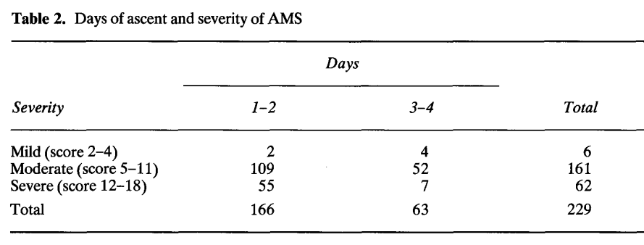
P<0.05

Slide 11
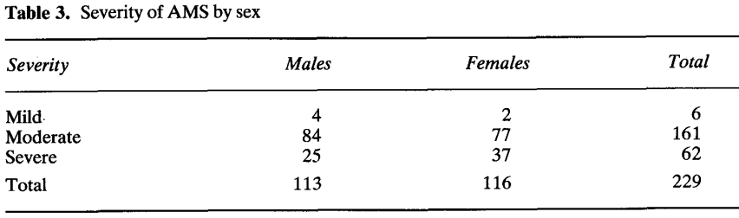
However the difference was not statistically significant

Slide 12
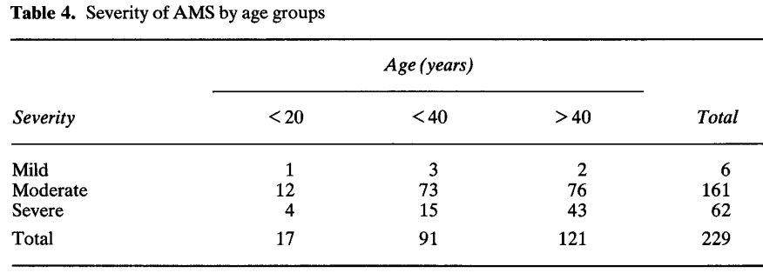

Slide 13
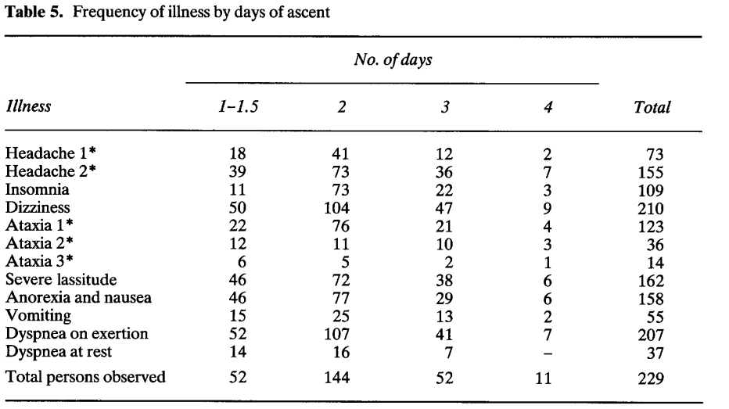

Slide 14
Treatment
Moderate illness: Acetazolamide
20 were sickest: Treated with Dexamethasone, Nifedipine
5 patients treated with hyperbaric bag

Slide 15
Differentials of AMS
Alcoholic hangover
Exhaustion
Dehydration
Viral infection
Carbon monoxide poisoning
Psychiatric illness

Slide 16
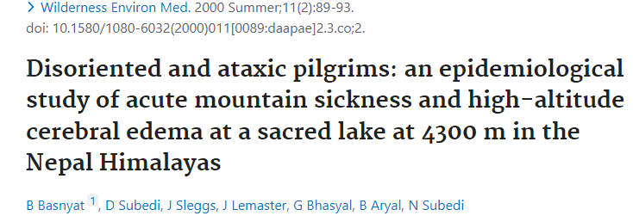
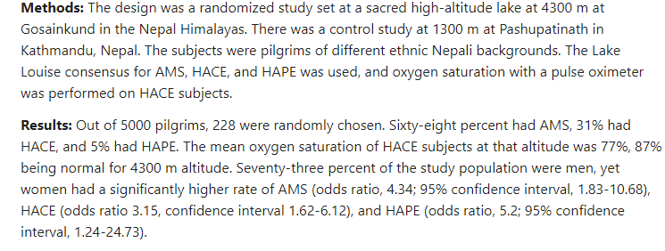

Slide 17
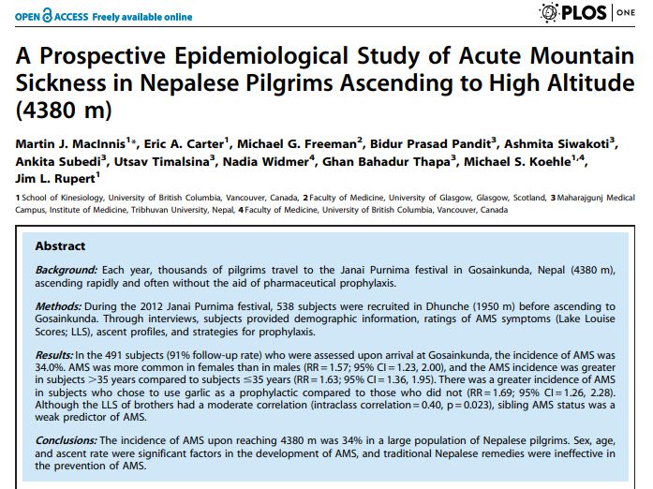

Slide 18
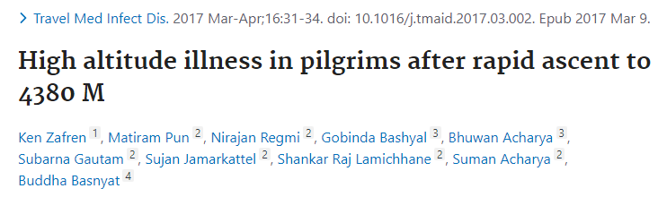
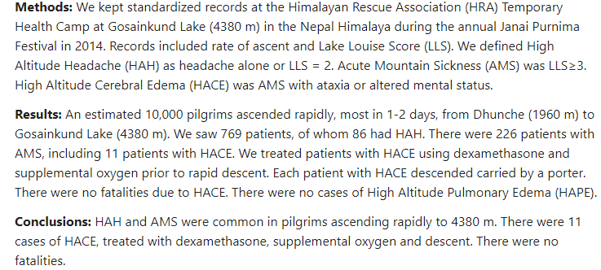

Slide 19
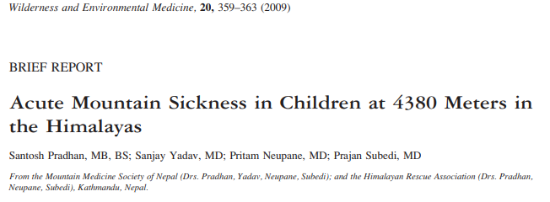
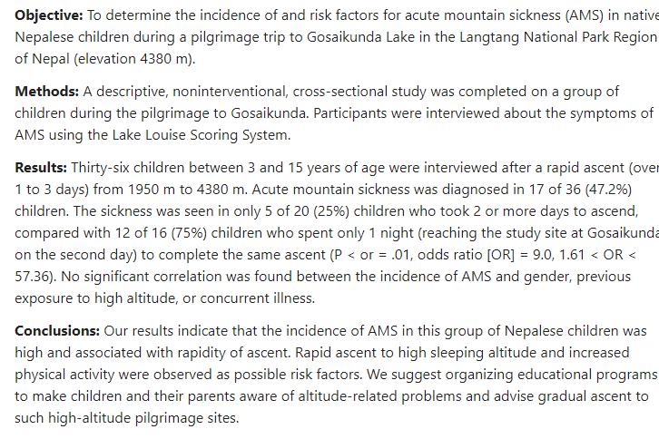

Slide 20
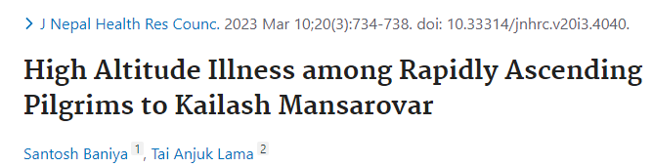
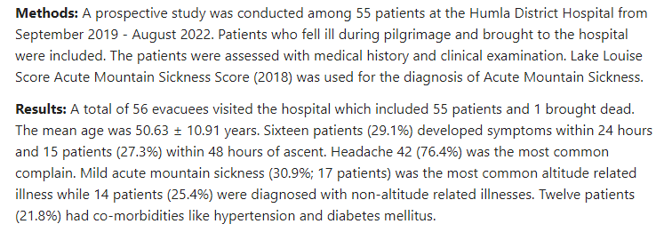

Slide 21
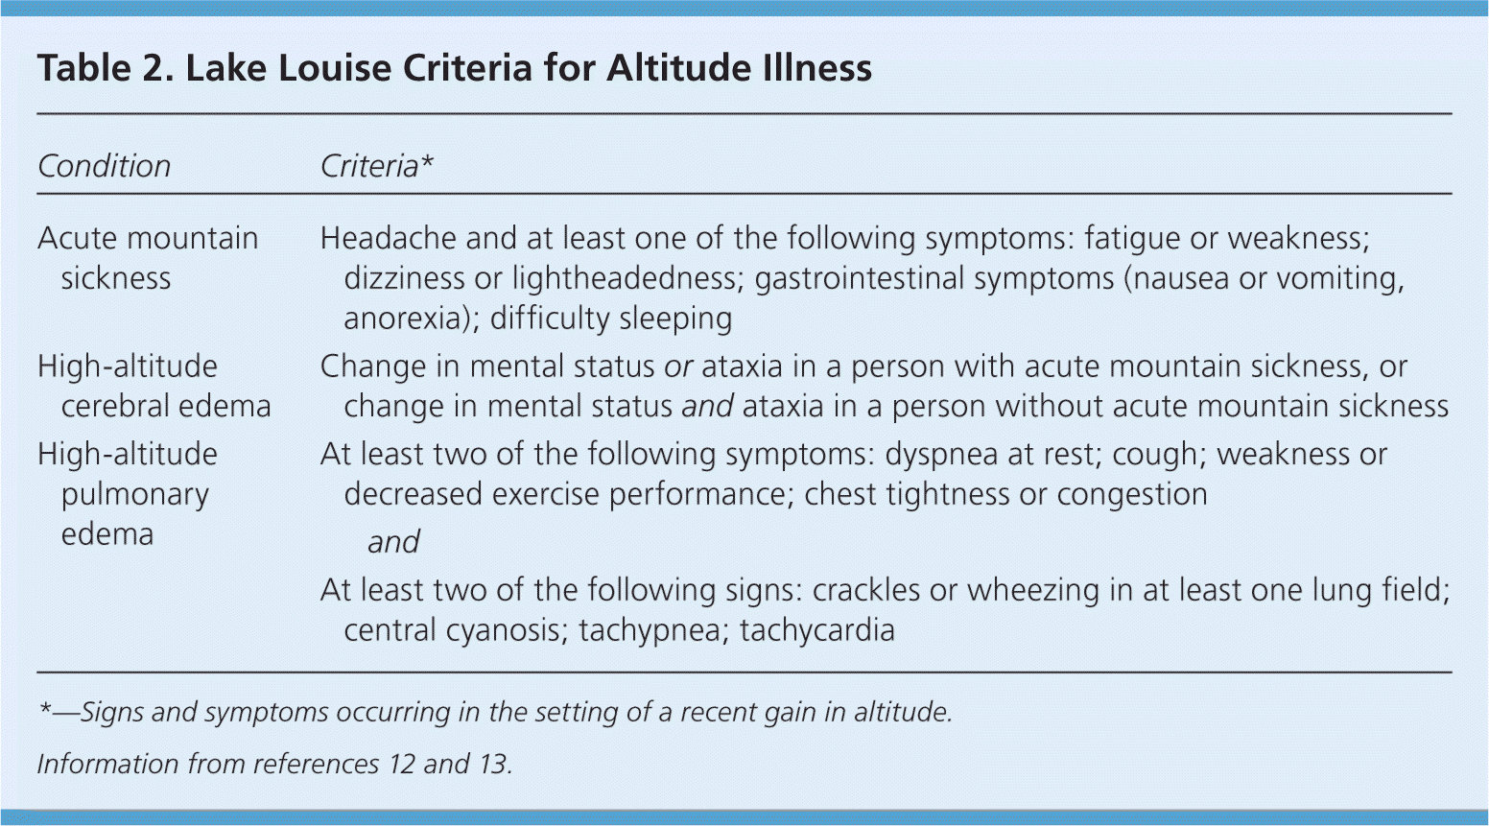
Altitude Illness: Risk Factors, Prevention, Presentation, and Treatment | AAFP

Slide 22
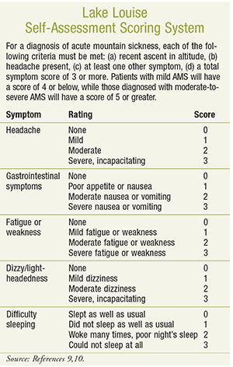

Slide 23
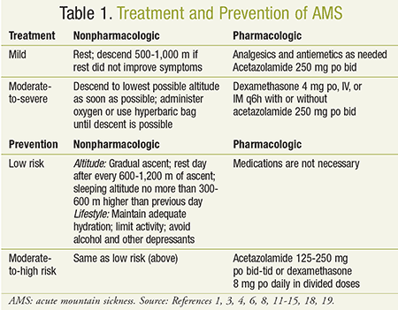

Slide 24
Future Prospects
AMS in pilgrims visiting via helicopter
Newer drug trials
Mass dissemination on AMS to general public.

Slide 25
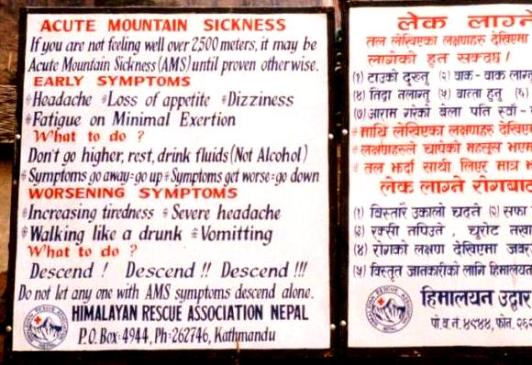
Take Home Message

Slide 26
Thank You

