Slide 1
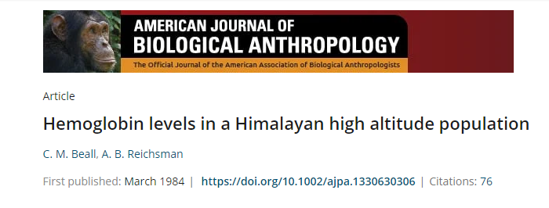
Presenter
Pashupati Pokharel
Intern Doctor
Tribhuvan University Teaching Hospital

Slide 2
Question to the audience:
What happens to hemoglobin at high altitude?

Slide 3
Cause of Elevated Hemoglobin in High Altitude
Primarily an adaptive response
Higher altitude »» low partial pressure of oxygen »» arterial hypoxia due to reduced ability of RBCs to extract oxygen »» increase in hypoxia induced erythropoiesis »» elevated hemoglobin

Slide 4
Introduction
Two highlands: Himalayan and Andean
Andean highlanders have high concentration of Hb than sea level
Himalayan and Tibetan highlanders have 1-2gm/dl Hb lower than the Andeans
Few studies have reported similar findings as well.
However multiple methodological shortcomings such as low sample size, no indication of age, sex, sample size.
Thus, making the relevance of this study.

Slide 5
Objectives
Estimate the hemoglobin levels of a large sample of healthy Himalayan highlander population
Compare the Hb levels of Himalayan and standard reference population
Compare with Andean highlander population

Slide 6
Methodology

Slide 7
Sample Population
Upper Chumik of Mustang district
Altitudes ranging from 3250 to 3560 meters
Inhabited by Tibetan speaking Buddhists
6 villages

Slide 8
Total population=270 (M=126; F=144)
All native to 3500+meters altitude (except 3)
Age range: 20-79 years
Apparently healthy (with no respiratory or cardiovascular illness)
Among 144 females, 44 were post-menopausal

Slide 9
Measurements
Hb measured by optical density technique using an American Optical Company hemoglobinometer.
Two authors analyzed for 1 patient with 0.5gm/dl as standard for correlation.
Serum ferritin measured by kit immunoradiometric technique (Amco Laboratories Inc., Houston Texas).

Slide 10
Statistical Analysis
Comparison made with sea level reference population free of hookworms and biochemical indications of iron, folate, and B12 deficiency anemia. (Central American population).
T-test to compare the means between the Tibetan population and standard reference population.
Mean ±SD, and tables of standard normal cumulative probabilities drawn to calculate the expected percent of sample lying within the range of reference population.

Slide 11
Results

Slide 12
Mean Hb
Adult males=16.1±1.2 gm/dl
Premenopausal adult females= 14.4±1.4gm/dl
Post menopausal females= 15±1.1gm/dl

Slide 13
Factors associated with Hb Levels
Males: weight increases Hb (no ass. with age and height)
+1 SD weight from mean increases Hb by 0.1gm/dl
No variation of Hb with age, height, and weight in both pre/post menopausal women

Slide 14
Comparison of Upper Chumik Hemoglobin with Reference Population

Slide 15
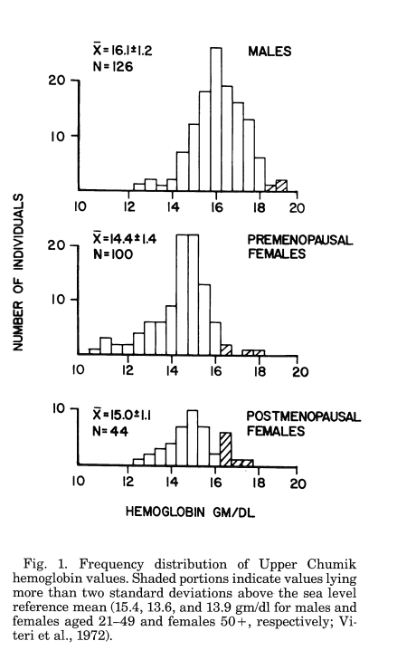
96%
93%
88%

Slide 16
Upper Chumik male and premenopausal female means are within 0.8gm SD of the sea level mean
Differences between the means at Chumik and sea level are statistically significant. (T-test: p<0.05)

Slide 17
59 individuals tested for serum ferritin
Only 2 (3% had serum ferritin <10ng/ml (clinically indicative of iron deficiency).

Slide 18
Discussion
Hb findings are similar to sea level despite high altitude in upper Chumik (only 5-6% higher).
Not related to nutritional deficiency because the staple diet here contains grains such as wheat, buckwheat, millet, and lentils as well as dairy products such as milk, butter, and yoghurt. (rich in folate, and B12).
Only 3% had serum ferritin indicative of iron deficiency anemia

Slide 19
Comparison with Andean Highlander Population

Slide 20
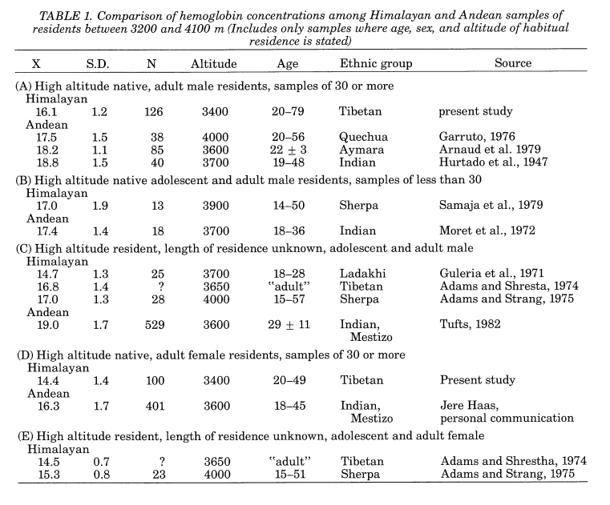

Slide 21
Reasons for Hb differences in Himalayas and Andes
Hb estimates done at lower altitudes in the Himalayas (3400m on average) compared to 3600m in the Andes.
Malnutrition causing anemia in Himalayan population.
Andean samples were from mining, and urban communities compared to rural and agricultural samples in Himalayas. Thus resulting in pulmonary disease and polycythemia in Andean population.
Chronic mountain sickness more prevalent in the Andes
Genetic makeup (European and American migrants living in the Andes)
Alternate adaptation

Slide 22
Conclusions
Healthy population may live at high altitude without significant increase in Hb concentration.
Himalayan and Andean highlander population differ in terms of hematological response to high altitude.
Comparative studies of oxygen transport, and hypoxic stress at high altitudes are required to explore the underlying mechanisms for these differences.

Slide 23
Critical Appraisal

Slide 24
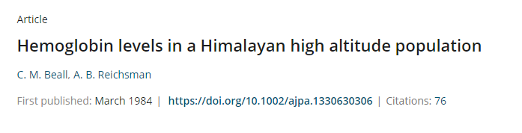
A. Title
Interesting but study design, study site are not clearly defined.

Slide 25
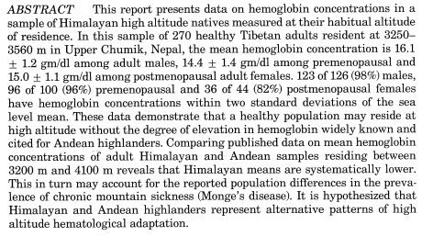
B. Abstract
Well written
But unstructured into background, methods, results, and conclusions which journal guidelines suggest to adhere on.

Slide 26
C. Introduction
Well written
Dives into existing literature
Objectives well defined
But all piled up in a single paragraph.

Slide 27
D. Materials and Methods
Study design: Not defined
Ethical considerations: Not mentioned
Sample size: Not calculated using standard statistical methods
Study population: Defined clearly
Sampling technique: Not discussed
Data collection tools and techniques: Well defined
Data management: Not discussed
Data analysis: Well discussed

Slide 28
E. Results
Socio-demographic parameters: Not elaborated
Main result (as per the objectives): Well written
Data presented in tables, charts, graphs, and other figures: Yes
Secondary findings, subgroup analysis: Partial
A section of discussion is added in the last part of result section (i.e. have given a hypothesis).

Slide 29
F. Discussion and Conclusion
Summarize the key findings in clear and concise language: Done
Interpretation of the results: Done
Comparison of study within the context of previous studies: Done
Discuss potential future research: Yes
Provide the reader with a “take-away” statement to end the manuscript: Yes
Limitations: Not mentioned

Slide 30
G. Limitations
Exact causes of low hemoglobin could not be pin pointed. Rather the study has given multiple hypotheses for the hemoglobin differences.
Serum ferritin measurements done for random cases without definite inclusion criteria.
Study has excluded the respiratory and cardiovascular diseases by history and examination which may have physician biasness, and population reluctance to tell symptoms, which is especially prevalent in a Himalayan country like Nepal.
Smoking habits of the sample was not taken into consideration.
Parasitic infestations were not ruled out.

Slide 31
Take Home Messages
Despite being almost 40 years old study it still has relevance at present scenario.
This study confirms that healthy population may live at high altitude without significant increase in hemoglobin concentration.
Himalayan and Andean highlander population differ in terms of hematological response to high altitude and the Himalayan high altitude population can be considered to have certain degree of mal-adaptation.
Comparative studies of oxygen transport, and hypoxic stress at high altitudes are required to explore the underlying mechanisms for these differences.
Research gap of chronic mountain sickness in the Himalayas needs to be explored.

Slide 32
Any Queries??
Suggestions??

Slide 33
Thank You

