Slide 1
Template for a Journal Club Presentation
Mountain Medicine Society of Nepal (MMSN)
June, 2020

Slide 2
The Big picture first…
Evidence Based Medicine (EBM) Process
• Ask a well built (focused) clinical question
• Search for the best evidence to answer the question
• Critically appraise the evidence
• Apply the evidence to the patient

Slide 3
Before you start…
Total lenth of session would be about 1 hour with core activity of about 45 minutes.
Plan your 45 minutes, roughly 20-25 minutes of talk with slides, and 25+ minutes of questions and discussion.
Get help from seniors before your talk to proofread it.

Slide 4
Start with the Outline of your talk
1. Why this paper?
2. General description of medical problem
3. Additional medical background
4. Aims of paper
5. Methods employed
6. Results
7. Comparison/evaluation of methods
8. Conclusions (of author)
9. Assessment of paper
10. Problems/Concerns
11. Summary/Conclusions (by you)

Slide 5
Putting in the perspective…
Review what the audience needs to know to understand the key contributions of the paper.
Why is the study important?
In particular, don’t assume they know all the biomedical jargon, or the content of key databases.
Be guided by the information in the Introduction

Slide 6

Start with a “Title” slide
The “Title of the Paper You’re Presenting”
Complete Bibliographic Citation
May include an interesting graphic or a question to grab attendees’ attention

Slide 7
Moving on…
Your talk should answer the following questions:
• What is new about the paper? (Introduction)
• Where does it fit in the context of prior work? (Background)
• What methods were used? (Methods)
• What were the primary results? (Results)
• What do the authors think these results mean? (Conclusions)
• What is your assessment of the paper? (Critique)

Slide 8
State the Aims/Major questions of the paper
Usually found in the Introduction of the paper
Helps to draw back in audience members who may have drided off
Gives you a “standard” to assess if the study achieves its stated aims

Slide 9
Methods employed…
Describe the method in sufficient technical detail so that the audience can discuss and evaluate it.
This is your central messsage, so will involve several slides.
It may be helpful to start with an overall “flow” slide that shows how data move through the various modules.
Avoid slides filled with equations unless critical to the discussion.

Slide 10
Results
Show their main results slide(s).
You may want to extract part of a complex figure, especially if the text or figure labels are in a small font

Slide 11
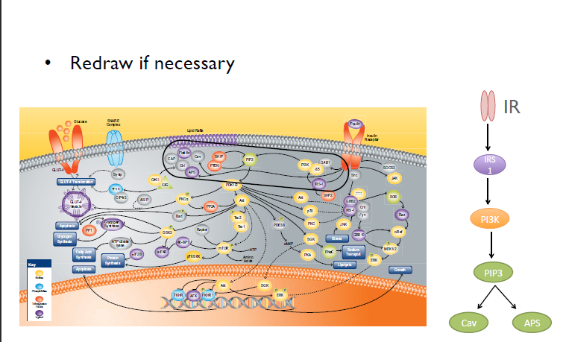
Keep it simple

Slide 12
PRESENTING FIGURES
When resizing figures – do not stretch
Slide Title may include finding of the figure
All figures should fill screen and be readable from the back of the room
Never put a figure without appropriate legend.

Slide 13
Authors conclusion
What did the authors conclude?
How did they summarize their work?
This is typically 1-3 bullet points.

Slide 14
Your assessment of the paper
Does the research method actually solve at least part of the biomedical problem?
Are the methods described in sufficient detail?
Could you figure out how to implement it from what they wrote?
Did they evaluate the method appropriately?
How general are the methods?
Can they be used to solve other problems?
Has the paper helped make a new contribution of biomedical knowledge?
Was this paper published in the right journal to find the audience who should care the most about it?

Slide 15
Problems/concerns
What do you like about the method, implementation, and evaluation, especially with reference to the technical informatics content?
What don’t you like?
Did the authors make unrealistic simplifying assumptions?
What might come next?

Slide 16
Summary
Do you accept all of the authors’ conclusions?
Which ones do you accept?

Slide 17
References and recommended reading
List citations for this paper and related background reading.

Slide 18
Acknowledgements
Thank those who assisted in choosing, evaluating and presenting the paper.

Slide 19
Last slide
The last slide will get the longest audience exposure―make it count!
Reiterate your important points and stimulate audience questions
The last slide should be a summary that recaps the main points of your talk

Slide 20
Some general advice
Imagine your typical audience member, and address the talk to them. Look for on-line reviews of the paper.
Use appropriate fonts, font sizes and background.
Content should be readable from the end of the room.
Look at papers that cited this paper; see what they did with the results.
Put your critiques in your assessment section, not when you first present the method.
Consider contacting the paper’s authors or seniors to clarify issues.

