Slide 1
MMSN JOURNAL CLUB
Presenter
Dr Sameer Basnyat
Editor-in-chief

Slide 2
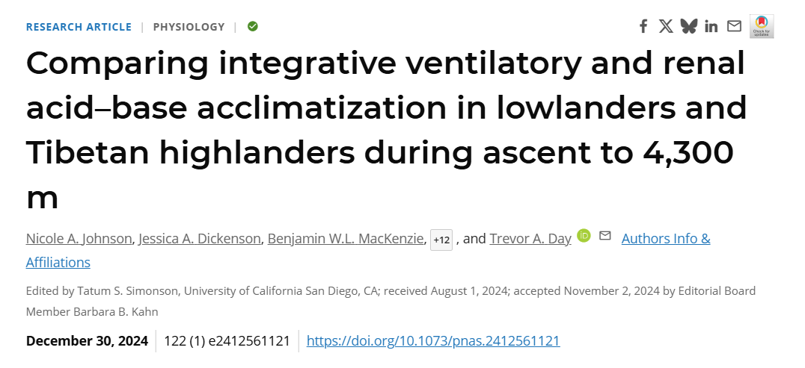

Slide 3
Introduction
14M+ people live above 3,500 m
5M people live around Tibetan highland
High altitude = low partial pressure of oxygen

Slide 4
Physiological Challenges at High Altitude
Hypoxia at high altitude causes physiological stress.
Leads to hyperventilation, which causes respiratory alkalosis.
Body must compensate to restore acid–base balance.
Incomplete compensation increases risk of AMS and other dysfunctions.

Slide 5
Mechanisms of High-Altitude Adaptation
Ventilatory acclimatization: breathing faster to increase oxygen uptake → lowers CO₂.
Renal compensation: kidneys excrete bicarbonate to counter respiratory alkalosis.
Tibetan highlanders are believed to have evolved superior responses, but mechanisms weren’t fully understood before.

Slide 6
Why this study?
Unique design: Head-to-head comparison of LL and TH during same ascent profile (rare in previous studies).
Relevance: Directly applies to altitude physiology, acclimatization, and TH adaptation.
New insight: Highlights the underappreciated role of renal compensation in high-altitude adaptation.

Slide 7
Study Objectives
Compare ventilatory and renal acclimatization in:
  Lowlanders (LL)
  Tibetan Highlanders (TH)
Study changes during incremental ascent from 1,400 m to 4,300 m over 8-9 days.
Determine if TH compensate better/faster and whether this affects blood pH stability.

Slide 8
Methods
Prospective cohort study with same ascent profile over 8–9 days.

Slide 9
Participants and Groups
LL: 15 (8F), Age 22.4 ± 3, BMI 25.0
TH: 14 (7F), Age 22.9 ± 4.5, BMI 22.3
Born: LL <1400m | TH >2500m
Age/sex matched, unacclimatized baseline

Slide 10
Parameters
Measurements at 1,400m (baseline) and 4,300 m:
  PCO₂, pH, HCO₃⁻, BE(Base Excess), SpO₂, SSCD(Steady-State Chemoreflex Drive)
  Capillary blood gas analysis used

Slide 11
Results

Slide 12
Ventilatory Acclimatization
• Both: ↑ ventilation, ↓ PCO₂
• TH > LL:
- Lower PCO₂
- Higher VA, SSCD

Slide 13
Renal Compensation
LL: ↓ HCO₃⁻, ↑ pH → Partial compensation
TH: ↓ HCO₃⁻, pH stable → Full compensation
Renal Reactivity: TH > LL
%-pH Compensation:
  TH - 88%
  LL - 62%

Slide 14
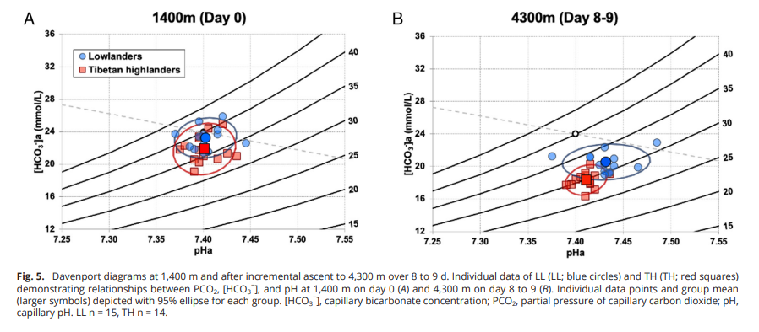
Davenport Diagram Summary
LL: Shift up/right → Incomplete compensation
TH: Shift down only → Full compensation

Slide 15
Interpretation
• TH: Stronger renal compensation
• Likely genetic (EPAS1, EGLN1)
• Maintain acid-base homeostasis

Slide 16
Implications
• Kidneys = Key adaptation organ
• LL → Higher risk of alkalosis/AMS
• Relevance:
- Pre-acclimatization
- HA travel safety
- Evolutionary biology

Slide 17
Strength
Same ascent profile = clean comparison
Age/sex matched
Real setting
Comprehensive blood gas data

Slide 18
Limitations
Capillary blood instead of arterial
Possible TH developmental exposures
No control for dietary factors (diet, hydration and physical activity)
Single High-Altitude endpoint(4300m)
Short term study design

Slide 19
Conclusions(of authors)
Tibetan highlanders have stronger and earlier renal compensation, enabling stable pH at altitude.
Suggests renal function is under evolutionary selection in high-altitude populations.
Acclimatization is not just ventilatory—renal physiology is critical.

Slide 20
Problems/Concerns
External validity: findings apply to TH Sherpas—unclear if same in Andean or Ethiopian populations.
No long-term follow-up: unsure if differences persist with prolonged exposure.
Sample size modest, though acceptable for HA field study.

Slide 21
Conclusion
This paper convincingly shows that renal mechanisms are central to high-altitude adaptation.
TH outperform LL not just in ventilation, but in acid-base homeostasis.
Suggests new research avenues: renal physiology, genetic markers, and AMS risk prediction.
Highly relevant to high-altitude research and mountaineering medicine.

Slide 22
Critical Appraisal
High-quality design, field-relevant, with strong implications.
Provides quantitative evidence of adaptation beyond just oxygen saturation.
Introduces practical metrics (renal reactivity, pH compensation) for future studies.

Slide 23
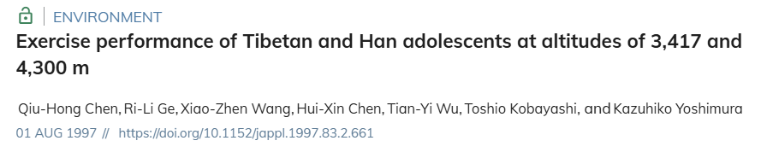
Similar/Related Articles

Slide 24
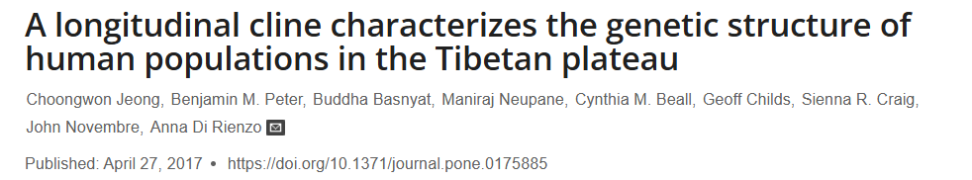

Slide 25
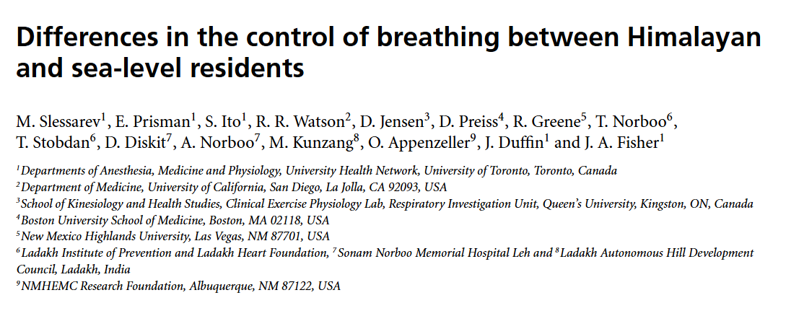

Slide 26
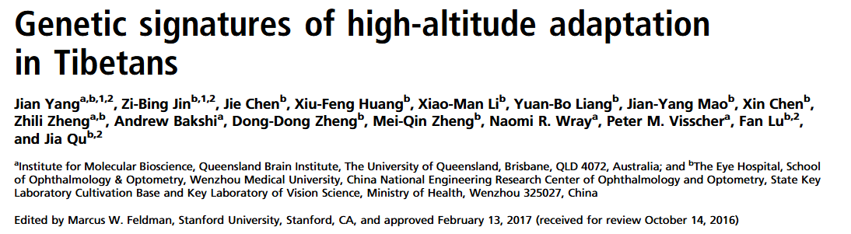

Slide 27
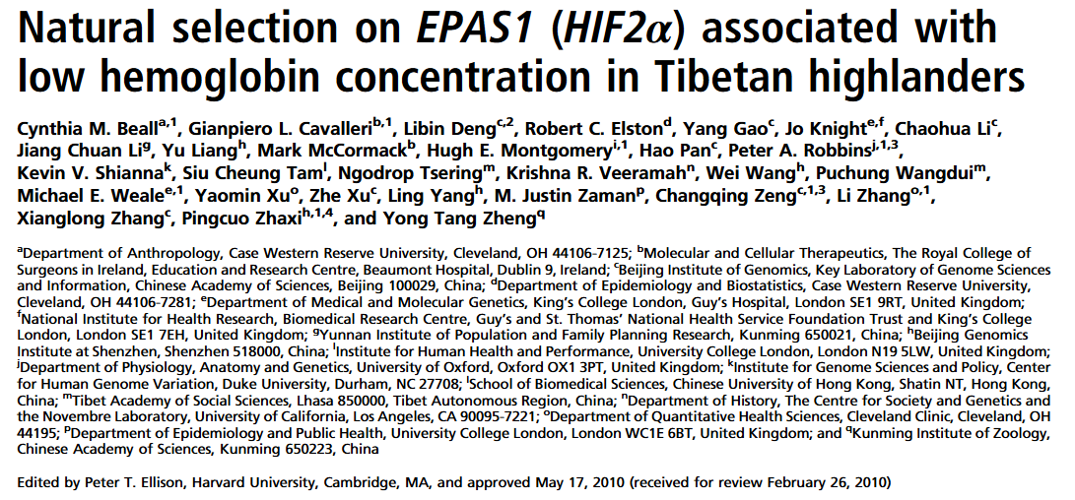

Slide 28
Any Queries?

Slide 29
Thank You

